Slide 1
OPERATING SYSTEMS
Distributed File Systems
Jerry Breecher

Slide 2
DISTRIBUTED FILE SYSTEMS
Overview:
Background
Naming and Transparency
Remote File Access
Stateful versus Stateless Service
File Replication
An Example: AFS

Slide 3
DISTRIBUTED FILE SYSTEMS
Definitions
A Distributed File System ( DFS ) is simply a classical model of a file system ( as discussed before ) distributed across multiple machines. The purpose is to promote sharing of dispersed files.
This is an area of active research interest today.
The resources on a particular machine are local to itself. Resources on other machines are remote.
A file system provides a service for clients. The server interface is the normal set of file operations: create, read, etc. on files.

Slide 4
DISTRIBUTED FILE SYSTEMS
Definitions
Clients, servers, and storage are dispersed across machines. Configuration and implementation may vary -
Servers may run on dedicated machines, OR
Servers and clients can be on the same machines.
The OS itself can be distributed (with the file system a part of that distribution.
A distribution layer can be interposed between a conventional OS and the file system.
Clients should view a DFS the same way they would a centralized FS; the distribution is hidden at a lower level.
Performance is concerned with throughput and response time.

Slide 5
DISTRIBUTED FILE SYSTEMS
Naming and Transparency
Naming is the mapping between logical and physical objects.
Example: A user filename maps to <cylinder, sector>.
In a conventional file system, it's understood where the file actually resides; the system and disk are known.
In a transparent DFS, the location of a file, somewhere in the network, is hidden.
File replication means multiple copies of a file; mapping returns a SET of locations for the replicas.
Location transparency -
The name of a file does not reveal any hint of the file's physical storage location.
File name still denotes a specific, although hidden, set of physical disk blocks.
This is a convenient way to share data.
Can expose correspondence between component units and machines.

Slide 6
DISTRIBUTED FILE SYSTEMS
Naming and Transparency
Location independence -
The name of a file doesn't need to be changed when the file's physical storage location changes. Dynamic, one-to-many mapping.
Better file abstraction.
Promotes sharing the storage space itself.
Separates the naming hierarchy from the storage devices hierarchy.
Most DFSs today:
Support location transparent systems.
Do NOT support migration; (automatic movement of a file from machine to machine.)
Files are permanently associated with specific disk blocks.

Slide 7
DISTRIBUTED FILE SYSTEMS
Naming and Transparency
The ANDREW DFS AS AN EXAMPLE:
Is location independent.
Supports file mobility.
Separation of FS and OS allows for disk-less systems. These have lower cost and convenient system upgrades. The performance is not as good.
NAMING SCHEMES:
There are three main approaches to naming files:
1. Files are named with a combination of host and local name.
This guarantees a unique name. NOT location transparent NOR location independent.
Same naming works on local and remote files. The DFS is a loose collection of independent file systems.

Slide 8
DISTRIBUTED FILE SYSTEMS
Naming and Transparency
NAMING SCHEMES:
2. Remote directories are mounted to local directories.
So a local system seems to have a coherent directory structure.
The remote directories must be explicitly mounted. The files are location independent.
SUN NFS is a good example of this technique.
3. A single global name structure spans all the files in the system.
The DFS is built the same way as a local filesystem. Location independent.

Slide 9
DISTRIBUTED FILE SYSTEMS
Naming and Transparency
IMPLEMENTATION TECHNIQUES:
Can Map directories or larger aggregates rather than individual files.
A non-transparent mapping technique:
name ----> < system, disk, cylinder, sector >
A transparent mapping technique:
name ----> file_identifier ----> < system, disk, cylinder, sector >
So when changing the physical location of a file, only the file identifier need be modified. This identifier must be "unique" in the universe.

Slide 10
DISTRIBUTED FILE SYSTEMS
Remote File Access
CACHING
Reduce network traffic by retaining recently accessed disk blocks in a cache, so that repeated accesses to the same information can be handled locally.
If required data is not already cached, a copy of data is brought from the server to the user.
Perform accesses on the cached copy.
Files are identified with one master copy residing at the server machine,
Copies of (parts of) the file are scattered in different caches.
Cache Consistency Problem -- Keeping the cached copies consistent with the master file.

Slide 11
DISTRIBUTED FILE SYSTEMS
Remote File Access
CACHING
A remote service ((RPC) has these characteristic steps:
The client makes a request for file access.
The request is passed to the server in message format.
The server makes the file access.
Return messages bring the result back to the client.
This is equivalent to performing a disk access for each request.

Slide 12
DISTRIBUTED FILE SYSTEMS
Remote File Access
CACHE LOCATION:
Caching is a mechanism for maintaining disk data on the local machine. This data can be kept in the local memory or in the local disk. Caching can be advantageous both for read ahead and read again.
The cost of getting data from a cache is a few HUNDRED instructions; disk accesses cost THOUSANDS of instructions.
The master copy of a file doesn't move, but caches contain replicas of portions of the file.
Caching behaves just like "networked virtual memory".

Slide 13
DISTRIBUTED FILE SYSTEMS
Remote File Access
CACHE LOCATION:
What should be cached? << blocks <---> files >>.
Bigger sizes give a better hit rate;
Smaller give better transfer times.
Caching on disk gives:
Better reliability.
Caching in memory gives:
The possibility of diskless work stations,
Greater speed,
Since the server cache is in memory, it allows the use of only one mechanism.

Slide 14
DISTRIBUTED FILE SYSTEMS
Remote File Access
CACHE UPDATE POLICY:
A write through cache has good reliability. But the user must wait for writes to get to the server. Used by NFS.
Delayed write - write requests complete more rapidly. Data may be written over the previous cache write, saving a remote write. Poor reliability on a crash.
Flush sometime later tries to regulate the frequency of writes.
Write on close delays the write even longer.
Which would you use for a database file? For file editing?

Slide 15
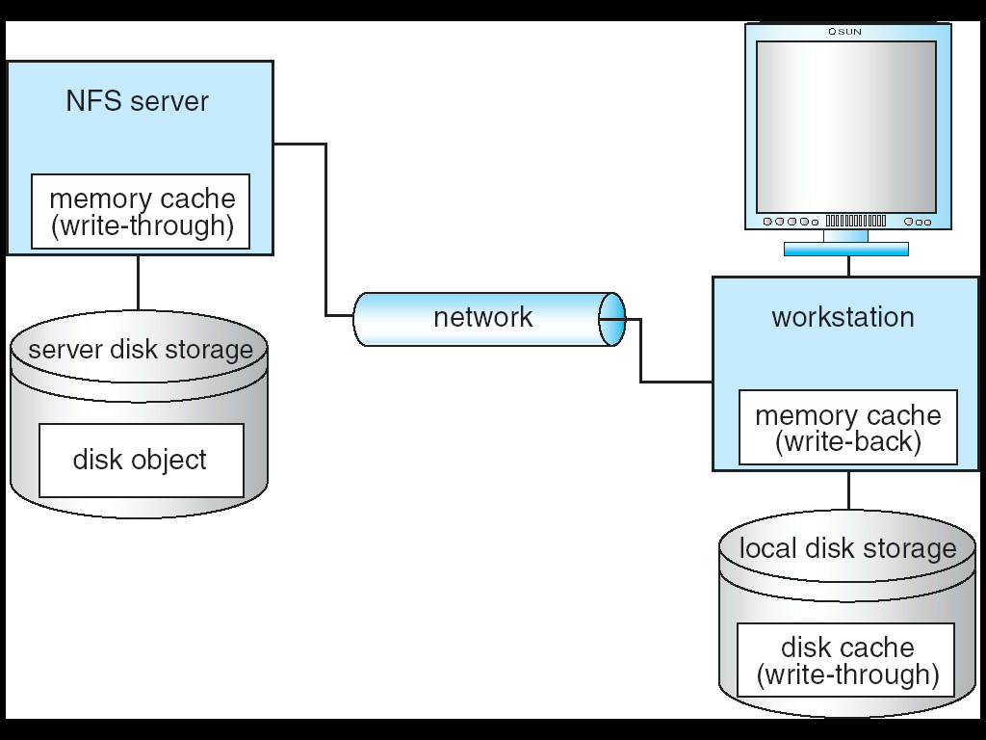
DISTRIBUTED FILE SYSTEMS
Example: NFS with Cachefs

Slide 16
DISTRIBUTED FILE SYSTEMS
Remote File Access
CACHE CONSISTENCY:
The basic issue is, how to determine that the client-cached data is consistent with what's on the server.
Client - initiated approach -
The client asks the server if the cached data is OK. What should be the frequency of "asking"? On file open, at fixed time interval, ...?
Server - initiated approach -
Possibilities: A and B both have the same file open. When A closes the file, B "discards" its copy. Then B must start over.
The server is notified on every open. If a file is opened for writing, then disable caching by other clients for that file.
Get read/write permission for each block; then disable caching only for particular blocks.

Slide 17
DISTRIBUTED FILE SYSTEMS
Remote File Access
COMPARISON OF CACHING AND REMOTE SERVICE:
Many remote accesses can be handled by a local cache. There's a great deal of locality of reference in file accesses. Servers can be accessed only occasionally rather than for each access.
Caching causes data to be moved in a few big chunks rather than in many smaller pieces; this leads to considerable efficiency for the network.
Cache consistency is the major problem with caching. When there are infrequent writes, caching is a win. In environments with many writes, the work required to maintain consistency overwhelms caching advantages.
Caching requires a whole separate mechanism to support acquiring and storage of large amounts of data. Remote service merely does what's required for each call. As such, caching introduces an extra layer and mechanism and is more complicated than remote service.

Slide 18
DISTRIBUTED FILE SYSTEMS
Remote File Access
STATEFUL VS. STATELESS SERVICE:
Stateful: A server keeps track of information about client requests.
It maintains what files are opened by a client; connection identifiers; server caches.
Memory must be reclaimed when client closes file or when client dies.
Stateless: Each client request provides complete information needed by the server (i.e., filename, file offset ).
The server can maintain information on behalf of the client, but it's not required.
Useful things to keep include file info for the last N files touched.

Slide 19
DISTRIBUTED FILE SYSTEMS
Remote File Access
STATEFUL VS. STATELESS SERVICE:
Performance is better for stateful.
Don't need to parse the filename each time, or "open/close" file on every request.
Stateful can have a read-ahead cache.
Fault Tolerance: A stateful server loses everything when it crashes.
Server must poll clients in order to renew its state.
Client crashes force the server to clean up its encached information.
Stateless remembers nothing so it can start easily after a crash.

Slide 20
DISTRIBUTED FILE SYSTEMS
Remote File Access
FILE REPLICATION:
Duplicating files on multiple machines improves availability and performance.
Placed on failure-independent machines ( they won't fail together ).
Replication management should be "location-opaque".
The main problem is consistency - when one copy changes, how do other copies reflect that change? Often there is a tradeoff: consistency versus availability and performance.
Example:
"Demand replication" is like whole-file caching; reading a file causes it to be cached locally. Updates are done only on the primary file at which time all other copies are invalidated.
Atomic and serialized invalidation isn't guaranteed ( message could get lost / machine could crash. )

Slide 21
DISTRIBUTED FILE SYSTEMS
Andrew File System
A distributed computing environment (Andrew) under development since 1983 at Carnegie-Mellon University, purchased by IBM and released as Transarc DFS, now open sourced as OpenAFS.
OVERVIEW:
AFS tries to solve complex issues such as uniform name space, location-independent file sharing, client-side caching (with cache consistency), secure authentication (via Kerberos)
Also includes server-side caching (via replicas), high availability
Can span 5,000 workstations

Slide 22
DISTRIBUTED FILE SYSTEMS
Andrew File System
Clients have a partitioned space of file names:
a local name space and a shared name space
Dedicated servers, called Vice, present the shared name space to the clients as an homogeneous, identical, and location transparent file hierarchy
Workstations run the Virtue protocol to communicate with Vice.
Are required to have local disks where they store their local name space
Servers collectively are responsible for the storage and management of the shared name space

Slide 23
DISTRIBUTED FILE SYSTEMS
Andrew File System
Clients and servers are structured in clusters interconnected by a backbone LAN
A cluster consists of a collection of workstations and a cluster server and is connected to the backbone by a router
A key mechanism selected for remote file operations is whole file caching
Opening a file causes it to be cached, in its entirety, on the local disk

Slide 24
DISTRIBUTED FILE SYSTEMS
Andrew File System
SHARED NAME SPACE:
The server file space is divided into volumes. Volumes contain files of only one user. It's these volumes that are the level of granularity attached to a client.
A vice file can be accessed using a fid = <volume number, vnode >. The fid doesn't depend on machine location. A client queries a volume-location database for this information.
Volumes can migrate between servers to balance space and utilization. Old server has "forwarding" instructions and handles client updates during migration.
Read-only volumes ( system files, etc. ) can be replicated. The volume database knows how to find these.

Slide 25
DISTRIBUTED FILE SYSTEMS
Andrew File System
FILE OPERATIONS AND CONSISTENCY SEMANTICS:
Andrew caches entire files form servers
A client workstation interacts with Vice servers only during opening and closing of files
Venus – caches files from Vice when they are opened, and stores modified copies of files back when they are closed
Reading and writing bytes of a file are done by the kernel without Venus intervention on the cached copy
Venus caches contents of directories and symbolic links, for path-name translation
Exceptions to the caching policy are modifications to directories that are made directly on the server responsibility for that directory

Slide 26
DISTRIBUTED FILE SYSTEMS
Andrew File System
IMPLEMENTATION – Flow of a request:
Deflection of open/close:
The client kernel is modified to detect references to vice files.
The request is forwarded to Venus with these steps:
Venus does pathname translation.
Asks Vice for the file
Moves the file to local disk
Passes inode of file back to client kernel.
Venus maintains caches for status ( in memory ) and data ( on local disk.)
A server user-level process handles client requests.
A lightweight process handles concurrent RPC requests from clients.
State information is cached in this process.
Susceptible to reliability problems.

Slide 27
DISTRIBUTED FILE SYSTEMS
Wrap Up
In this section we have looked at how files systems are implemented across systems. Of special concern is consistency, caching, and performance.

